Slide 1
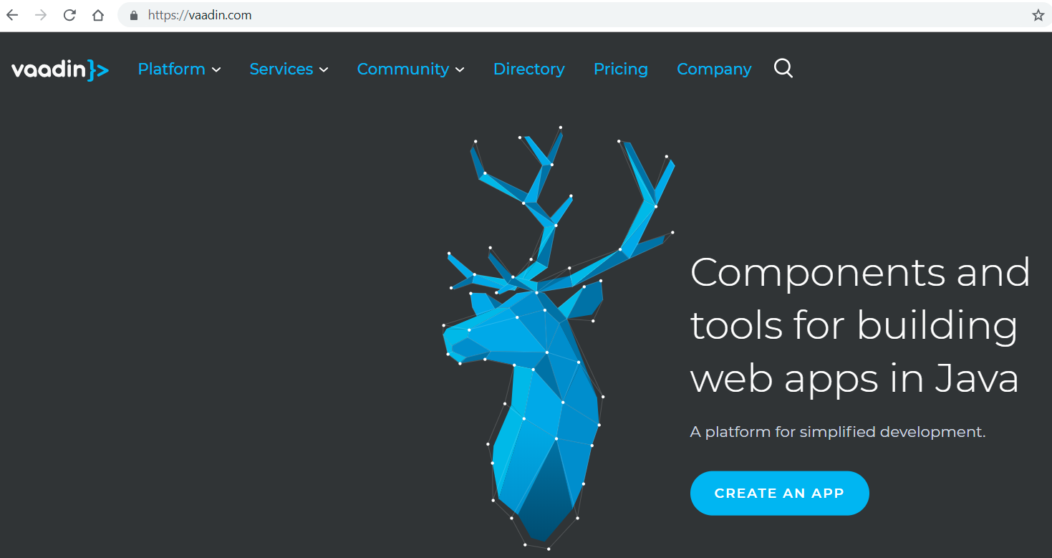
Vaadin Framework

Slide 2
Vaadin Framework
Verzie 7, 8 využívali technológiu GWT pre pre generovanie HTML, CSS, JavaScript na základe Java kódu
Verzie 10 (LTS) a 11 využívajú web components
Pre web components od Vaadin je dostupné Java API

Slide 3
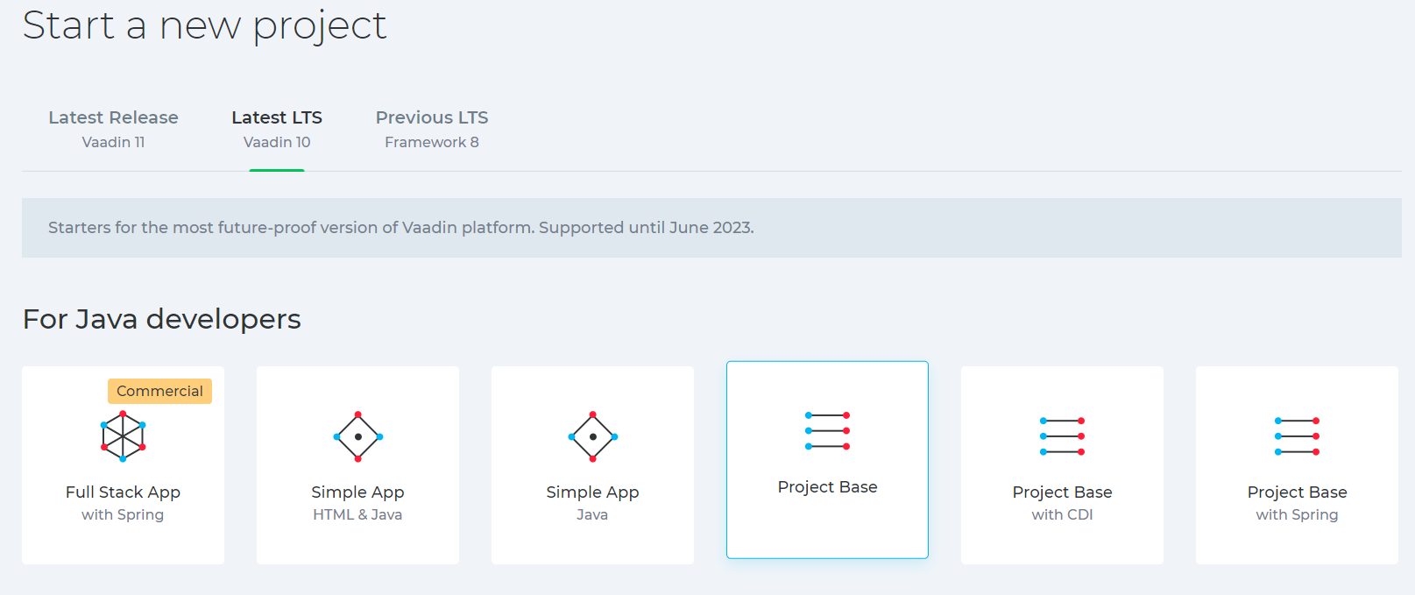
Vaadin 10 aka Vaadin Flow

Slide 4
Quick Demo Web App with CRUD
download/unzip project base
mvn install
open eclipse
check eclipse - build automatically
check eclipse – maven settings
import project into eclipse

Slide 5
Quick Demo Web App with CRUD
create maven launcher for jetty:run
start in debug mode
check http://localhost:8080
while still running the jetty server, update MainView according to vaadin tutorial
refresh the web page
continue with modifications until you get full CRUD web application

